Slide 1

INDUSTRIAL TRANING REPORT 2015 ON “BASIC TECHNIQUES OF TELEVISION PRODUCTION & TRANSMISSION AT DOORDRASHAN KENDRA,PATNA”
OM PRAKASH YADAV
ELECTRONICS AND COMMUNICATION
LNCTS

Slide 2
CONTENTS
INTRODUCTION
PRODUCTION UNIT
STUDIO
POST CONTROL ROOM
MAIN SWITCHING ROOM
EARTH STATION
OB VAN
TRANSMISSION

Slide 3
INTRODUCATION
PUBLIC SERVICE BROADCASTER
EQQUIPED WITH
TWO STUDIOS
TWO TERRESTRIAL TRANSMITTER
ONE DIGITAL UPLINK STATION
SATELLITE : INSAT-4B
LOOKING ANGLE : 93.5DEGREE EAST
DOWNLINK FREQUENCY : 3831.5MHZ
POLARISATION : VERTICAL

Slide 4
PRODUCATION UNIT
STUDIO
POST CONTROL ROOM
VIDEO STORAGE & TRANSMISSION
MAIN SWITCHING ROOM
DIGITAL EARTH ROOM

Slide 5
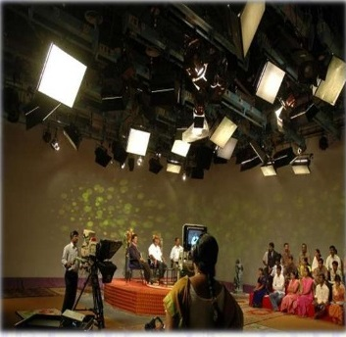
STUDIO
CAMERA
LIGHTNING
MICROPHONES
VISION MIXER & AUDIO CONSOLE
ACOUSTIC
SUPPORTING SERVICE LIKE
>A.C.
>U.P.S

Slide 6
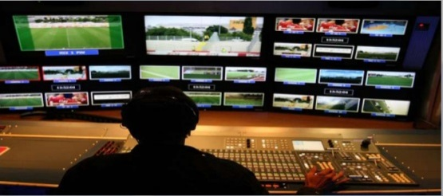
PRODUCTION CONTROL ROOM
MINOR EDITING
MONITIRING
STUDIOLIGHT
MICROPHONE
DIRECT THE CAMERA MAN
SELECT THE ANGLES SOUND PARAMETER

Slide 7
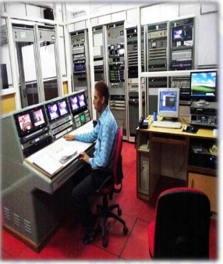
MAIN SWITCHING ROOM
MONITORING
ROUTED
STORAGE OF
A. CAMERA UNIT
B. VISION MIXER
C. AUDIO PROCESSOR

Slide 8
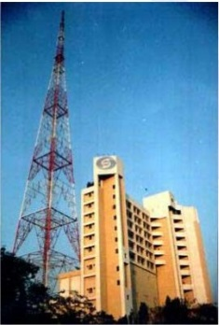
EARTH STATION
BOARD CASTING OF SIGNAL
UPLINK CENTRE
TWO TYPES :
ANALOG
DIGITAL
DIGITAL EARTH STATION ARE MOSTLY USED.

Slide 9
WORKING UNIT FOR AUDIO
MICROPHONE
MATRIX
MUX
24:1
ENCODER
MICROPHONE
MICROPHONE
EARTH STATION
MICROPHONE

Slide 10
WORKING UNIT FOR VIDEO
CAMERA
CAMERA CONTROL UNIT
PAL ENCODER
PICTURE IN PICTURE
TRANSMITTER
EARTH STATION
ENCODER

Slide 11
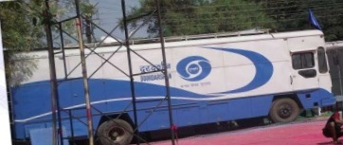
OB VAN
OUT SIDE BOARDCASTING
ELECTRONICS FIELD PRODUCTION
COVER TELEVISIONNEWS & SPORTS EVENT.
REMOTE BOARDCASTING TELEVISION STUDIO.

Slide 12
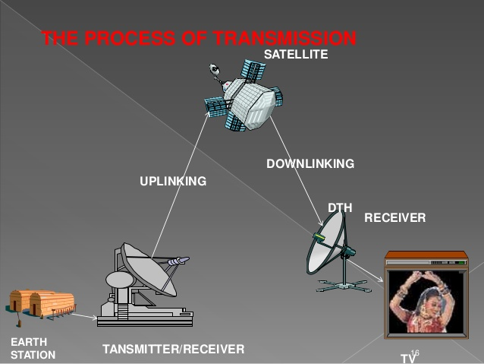
TRANSMISSION

Slide 13
THANK YOU !

